Slide 1
Insurance & Healthcare Payers
AI orchestration for claims, members, and policies — powered by the #1 iPaaS
Notes:
Slide Structure:
Slide 1: Title + Hook
Title: "Accelerating Banking Operations with AI & Automation"
Subtitle: [Prospect Bank Name] + Workato
Visual: Banking imagery (not stock handshake clichés)
Script: "Thanks for the time today. I want to share how leading banks are using automation to transform loan processing, compliance, and customer experience..."
Slide 2: The Challenge (Industry-Specific)
Headline: "Banks Are Caught Between Growth Pressure and Operational Complexity"
Content (3 visual stats):
📉 "Customer expectations: Same-day loan decisions"
⚠️ "Reality: 7-14 day processing times, 23% abandonment"
💰 "Impact: $4.2M in lost revenue annually for mid-size banks"
Visual: Icons + brief stats (not bullet points)
Script: "What we're hearing from banks like yours: customers expect instant decisions, but manual processes across Salesforce, your LOS, and core banking create bottlenecks..."
Slide 3: The Workato Approach (Solution Framework)
Headline: "Orchestrate Data, Systems & AI Across Your Banking Operations"
Content (3 capability pillars with icons):
🔗 Connect Everything: 1200+ connectors (Salesforce, nCino, Temenos, SAGE, Guidewire)
🤖 Add Intelligence: AI agents for underwriting, fraud checks, compliance
⚡ Empower Teams: Business users build workflows, not just IT
Visual: Simple architecture diagram showing systems flowing through Workato
Script: "Workato sits in the middle, orchestrating data between your CRM, loan origination, core banking, and compliance systems. Your business teams can build and modify these workflows without waiting on IT..."
Slide 4: Proof (Customer Success Snapshot)
Headline: "[Similar Bank/Credit Union] Achieved These Results in 6 Months"
Content (Before/After metrics):
Loan processing: 7 days → 4 hours ⚡
Cost per loan: $450 → $180 💰
Compliance violations: 12 → 0 ✅
FTE redeployed: 15 employees to customer service 👥
Visual: Customer logo + headshot + quote (if approved)
Quote: "Workato gave us the agility to launch new products without rip-and-replace." - VP Digital Banking
Script: "Here's a credit union similar to you in size and tech stack. They were struggling with the same loan processing bottleneck. After implementing Workato..."
Slide 5: Next Steps (Clear CTA)
Headline: "Let's Explore What's Possible for [Prospect Name]"
Content:
✓ Discovery Workshop (2 hours): Map your loan origination process
✓ Value Assessment (1 week): Quantify your automation opportunity
✓ Pilot Use Case (30 days): Prove ROI with one workflow
Visual: Simple timeline graphic
CTA: "Can we schedule a 2-hour workshop with your lending and IT teams?"
Script: "I'd love to do a deeper dive on your specific environment. We typically start with a discovery workshop where we map your current loan process, identify automation opportunities, and build a business case..."
Customization Zones for Partners/Sellers:
Slide 1: Add partner logo (if GSI co-sell)
Slide 2: Swap industry stats (use different challenge if prospect cares more about compliance than loans)
Slide 4: Change customer proof to closest match (community bank vs. regional bank vs. credit union)

Slide 2


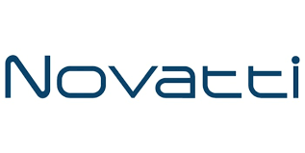

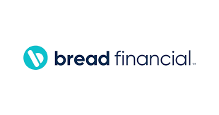
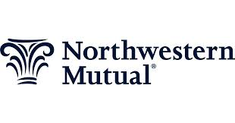
Accounts opened.
Loans approved.
Customers answered.
Work done!
Notes:
Top vertical segment messaging

Slide 3
The pressure is real. The window is closing.
Enterprise Agility: 68% of insurance CIOs cite legacy system integration as the #1 barrier to digital transformation (KPMG). Guidewire, Duck Creek, and legacy COBOL must connect to cloud apps — without rip-and-replace. Risk Reduction: Average data breach cost in healthcare/insurance = $9.77M (IBM). Every automated action needs a complete audit trail. Every AI agent needs HIPAA-compliant, governed access. Efficiency & OrCA: Administrative costs = 25-30% of US health insurance spending (CMS). Every 1% combined ratio improvement = $650M for a top-10 P&C carrier (Swiss Re). Revenue Growth: Each 0.5-star Star Rating improvement can mean $100M+ in CMS quality bonus payments. Embedded insurance market reaches $700B by 2030 (Swiss Re). API connectivity is the entry requirement.
$11 per manual prior authrequest (CAQH benchmark) — vs. under $2 automated. 80% cost reduction waiting to be captured.
Notes:
Align with Value drivers of WSS.
—--------
Discover time - what are you needed to solve??

Slide 4
Built for the insurance & health payer tech stack
Enterprise MCP Server Templates
Turn claims and underwriting workflows into secure MCP servers. HIPAA BAA available. Human-in-the-loop for claim denials and PA exceptions.
AI Genies
FNOL Genie | IDP Genie | Prior Auth Genie | Care Gap Genie | Support Genie | Compliance Filing Genie
Core System Connectors
Notes:
How do we fit into the Banking ecosystem.
Connectors - Orchestration out

Slide 5
Four priorities. Real results.
FNOL Intake & Claims Automation
Prior Authorization (CMS FHIR Mandate)
Member Onboarding & Eligibility
Policy Administration & Renewal Automation

Slide 6
Use Case: FNOL Intake & Claims Automation
Current state: Multi-channel FNOL with manual routing; 2-5 day acknowledgment cycles; adjuster capacity wasted on intake

Slide 7
Why Workato for Insurance & Healthcare Payers

Slide 8
Insurance leaders already running on Workato
Helia“Workato was pivotal in helping us enhance our customer experience offering.” — Neil Rodgers, Digital Solutions Director 4x more developer capacity • 35% time savings • AWS Bedrock + Anthropic Claude LLM for IDP • $52K ARR, 158 recipes, full platform adoption including Zero Data Logging
RadianMortgage Insurance: Claims, billing, and compliance orchestrated $712K ARR • 158 active recipes • Salesforce + Oracle + Vertex + Billing Center connected • EKM + Event Streams + Audit Streaming active • Full regulatory audit trail
Healthfirst
NYC nonprofit managed care organization — member services at scale $733K ARR • 575 active recipes • 3+ business units • Acqueon + Amazon DynamoDB + Workbot + Event Streams + APIM + WFA • Cloud-native autoscaling handles open enrollment surges without infrastructure provisioning
Notes:
Links to each of the customer reference packages.

Slide 9
Helia: 4x Developer Capacity. 35% Time Savings. AI-First.
“Workato was pivotal in helping us enhance our customer experience offering. They moved quickly, deployed quickly, listened to Helia at every step of the way, and strived for perfection.” — Neil Rodgers, Digital Solutions Director, Helia Challenge: Custom Java code for invoice generation and approval was consuming developer capacity. AI-first strategy stalled without a scalable IDP and orchestration foundation. Outcomes: 4x more developers available after replacing custom Java with Workato recipes | 35% time savings on invoice generation and approval workflows | AWS Bedrock + Anthropic Claude LLM deployed for AI document processing | Cloud-native integration now serves as central IT problem-solving platform across the tech stack. Workato how: IDP Genie on AWS Bedrock/Claude extracts invoice data → Teams approval routing → SAP ERP submission. POWER differentiator: Enterprise MCP + Zero Data Logging + Audit Streaming. Industry: Mortgage Insurance, Australia. $52K ARR, 158 recipes, full platform adoption.

Slide 10
Radian: $712K ARR — Claims, Billing & Compliance on One Platform
Challenge: Mortgage insurance carrier needed to connect origination, billing, claims, and compliance systems without custom point-to-point integrations across Salesforce, Oracle, and Vertex. Outcomes: $712K ARR, 158 active recipes across multiple lines of business | Salesforce, Oracle, Vertex, and Billing Center connected and orchestrated | Data Integration, APIM, Event Streams, and EKM all active | Enterprise key management and complete audit trail for regulatory compliance. Workato how: Salesforce (origination) → Oracle (ERP) → Vertex (tax compliance) → Billing Center (premium billing) → Data Integration to Snowflake. Real-time event-driven architecture with Event Streams. POWER differentiator: EKM + Audit Streaming + Zero Downtime Upgrades. Industry: Mortgage Insurance, USA.

Slide 11
Healthfirst: 575 Recipes. 3+ BUs. Health Payer at Scale.
Challenge: NYC nonprofit managed care organization needed to connect claims, member services, care management, and IT operations across 3+ business units — with open enrollment volume spikes 10-50x normal. Outcomes: $733K ARR, 575 active recipes, 3+ business units | Acqueon (member communication), Amazon DynamoDB, Workbot, Event Streams, APIM, and WFA all active | CI/CD for GitHub automated | Cloud-native autoscaling handles open enrollment surges without infrastructure provisioning. Workato how: OrCA handles open enrollment volume spikes automatically. Enterprise MCP connects member services AI agents to claims and eligibility data. Workbot enables internal team self-service workflows. SCALE differentiator: OrCA + Cloud Native Autoscaling. Industry: Health Insurance Payers (Medicare, Medicaid, Commercial), New York.

Slide 12









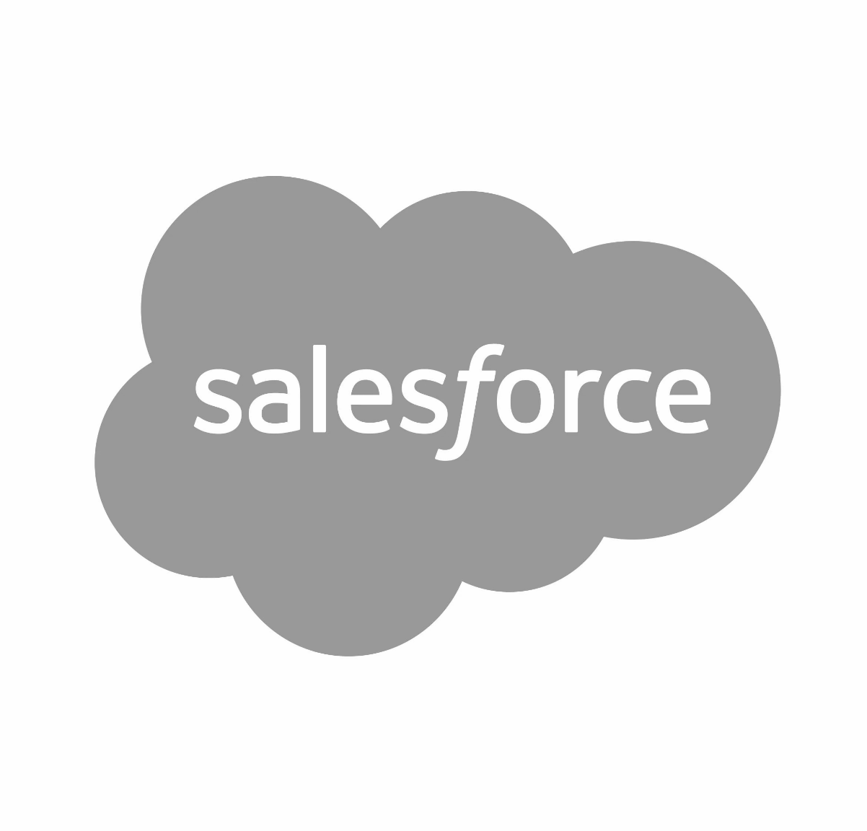



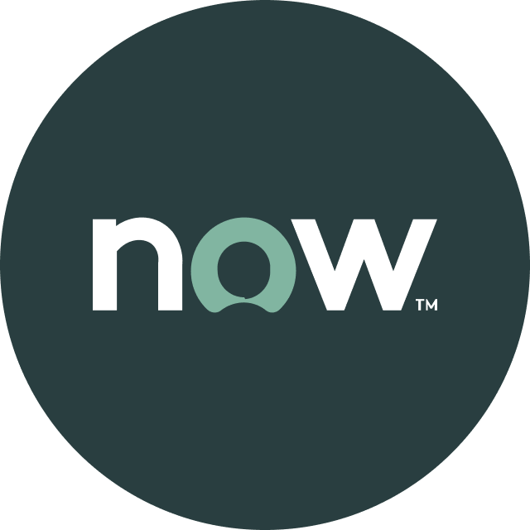


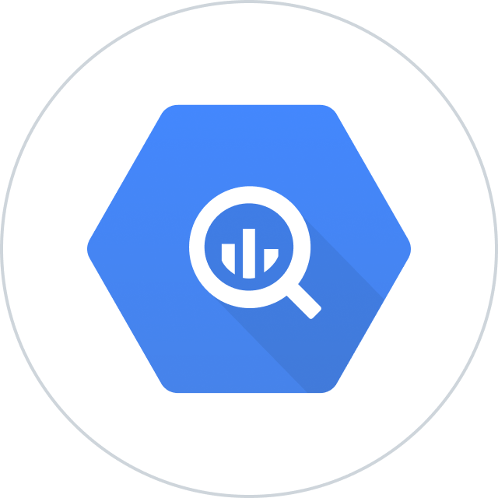


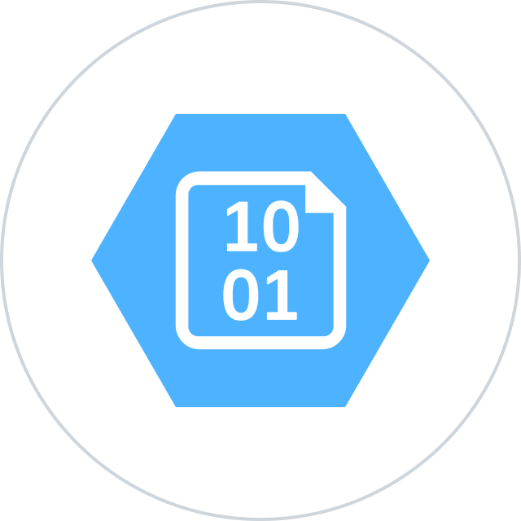


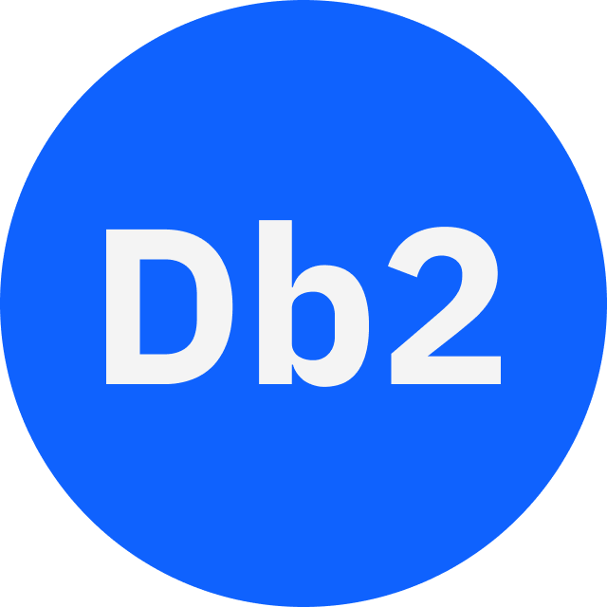




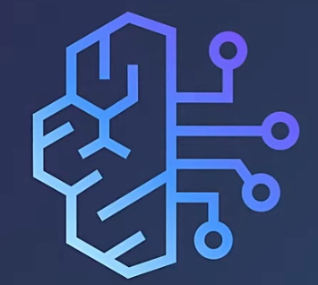
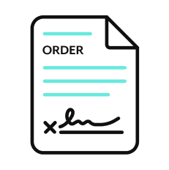

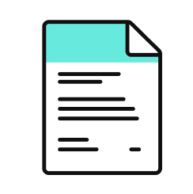
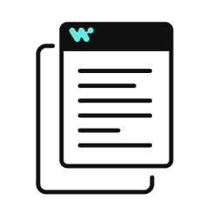




Orchestration for the Agentic Era—Powered by the #1 iPaaS.
I
Build agents with us
Go faster with Enterprise Skill packs and Workato Genies
W O R K A T O E N T E R P R I S E M C P
P L A T F O R M A G E N T S
E N T E R P R I S E S K I L L S
T R U S T
MCP Gateway
Observability
New simpler graphic
Solution Architect (AIRO™)
Skills Builder
MCP Composition
MCP Registry
MCP Proxy
Governance
O R C H E S T R A T I O N
Security
Data Scientist (Acumen)
Process Automation
Application Integration & B2B
Compliance
Data Orchestration
API Management
Explainability
Powered by iPaaS+
U N I V E R S A L C O N N E C T I V I T Y
SaaS/On-prem
Data Warehouse/ Data Lakes
Databases
LLMs
Unstructured
Traditional
Invoice
Media
Transcripts
Contracts
SFTP
Mainframe
Custom
Archives
Notes:
This is Workato ONE —Orchestration for the Agentic Era—Powered by the #1 iPaaS.
Unlike solutions that give you pieces of the puzzle, Workato ONE delivers the complete agentic enterprise:
Workato ONE One platform for data, apps, and agents
Workato GO puts enterprise search with Deep Action™ directly in every employee's hands
Workato Agentic builds and deploys production-ready agents with full enterprise context
Workato Enterprise MCP One trusted bridge for every agent to connect to applications and systems safely and securely
Workato Orchestrate powers complex workflows across teams, systems, and agents
All built on universal connectivity to 10,000+ applications and data sources
What makes this different? True Enterprise Orchestration.
Everyone talks about integration—APIs, MCP, basic workflows. But enterprise orchestration is fundamentally different. It's:
Transactionality that ensures every action completes or rolls back cleanly
In-sequence and exactly-once delivery so your financial transactions never duplicate
Runtime authentication and RBAC that enforces your security policies in real-time
PII obfuscation and data governance that maintains compliance automatically
Event-driven, batch, and real-time triggers that handle any integration pattern
Plus something no one else has: 1 million+ Enterprise Skills—pre-built, production-tested capabilities that encode your business logic, not just API calls. When an agent needs to "process a return," it doesn't just update a field—it orchestrates the entire business process across systems, with all the exception handling, approvals, and compliance checks your enterprise requires.
This unified approach enables true multi-agent orchestration. Your agents don't just connect—they inherit your enterprise's operational intelligence.

Slide 13

Thank you

Slide 14
Appendix of slides

Slide 15
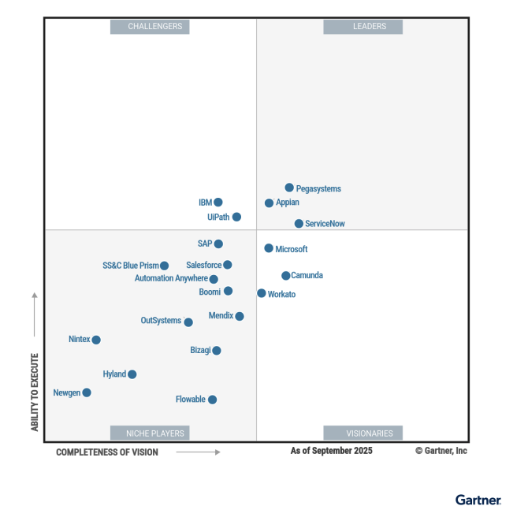
Leader in platforms and orchestration
Gartner iPaas : Leader - 7x
Visionary

